Slide 1
CS 0007: Introduction to Java
Lecture 4
Nathan Ong
University of Pittsburgh
September 12, 2016

Slide 2
boolean
Two values only:
  true
  false
We can also assign the variable an expression to be evaluated.

Slide 3
boolean Operators
&& – Logical AND
|| – Logical OR
! – Logical NOT
boolean needUmb = rain || cloud;
Parentheses can be used as a way to group

Slide 4
Truth Tables
A | B | A&&B
T | T | T
T | F | F
F | T | F
F | F | F

Slide 5
Truth Tables
A | B | A||B
T | T | T
T | F | T
F | T | T
F | F | F

Slide 6
Truth Tables
A | !A
T | F
F | T

Slide 7
Order of Operators
1. ! – Logical NOT
2. && – Logical AND
3. || – Logical OR
boolean needUmb = rain || !sun;

Slide 8
Conditional Logic
“If … then …”
Does not have an operator in Java
A | B | A→B
T | T | T
T | F | F
F | T | T
F | F | T

Slide 9
Conditional Logic
We can use an equivalent statement to get the result we want.
A | B | A→B
T | T | T
T | F | F
F | T | T
F | F | T

Slide 10
Conditional Logic
We can use an equivalent statement to get the result we want.
A | B | A→B
T | T | T
T | F | F
F | T | T
F | F | T

Slide 11
Conditional Logic
We can use an equivalent statement to get the result we want.
A | B | !A||B
T | T | T
T | F | F
F | T | T
F | F | T

Slide 12
Order of Operators
1. ==/!= – Equality/Non-equality
2. ! – Logical NOT
3. && – Logical AND
4. || – Logical OR
boolean same = bool1 == bool2;

Slide 13
Bad Coding Practice
boolean isTrue = bool1 == true;

Slide 14
int
Integers
We can also assign the variable an expression to be evaluated.

Slide 15
int Operators
+ – Addition
– – Subtraction
* – Multiplication
/ – (Integer) Division
% – Modular Operation
Follows normal rules of order of operation (PEMDAS)

Slide 16
Integer Division
Removes (truncates) the Mantissa (numbers after the decimal point)
5 / 2 → 2
20 / 3 → 6

Slide 17
Modular Arithmetic
Remember back to grade school division:
5 divided by 2 equals 2 remainder 1
5 % 2 → 1
20 divided by 3 equals 6 remainder 2
20 % 3 → 2

Slide 18
Integer Division + Modular Arithmetic
They fit nicely together:
5 divided by 2 equals 2 remainder 1
5 / 2 → 2
5 % 2 → 1
20 divided by 3 equals 6 remainder 2
20 / 3 → 6
20 % 3 → 2

Slide 19
More int Operators
Special operators convert two ints into a boolean by comparing them
== – Equality
!= – Non-Equality
> – Greater than
>= – Greater than or equal to
< – Less than
<= – Less than or equal to
Evaluated AFTER PEMDAS

Slide 20
More int Operators
5 == 0?
6 > 7?
4 <= 4?
!(8 < 3)?
(3 / 2 > 9 % 3) && (10 <= 5*3)?

Slide 21
double
Decimal numbers
Cannot trust this for calculations that require precision due to representation limits
All int operations can be applied to doubles, except modular arithmetic (%)
Division is regular

Slide 22
Mixing Types with Division
5 / 2 → 2
5.0 / 2.0 → 2.5
5.0 / 2 → ?
5 / 2.0 → ?

Slide 23
char
Single characters
CANNOT use + to combine two characters together.
Internally represented as a very small number in American Standard Code for Information Interchange (ASCII) representation.

Slide 24
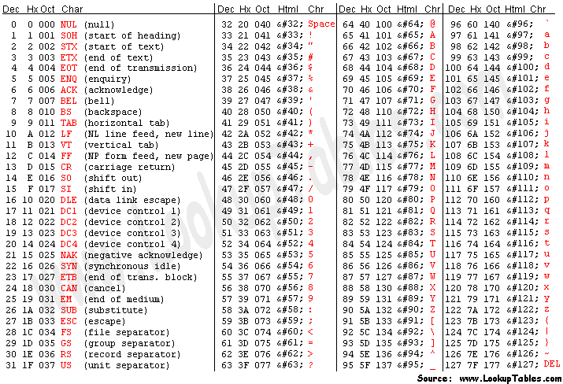
ASCII Table

Slide 25
char Operators
Special operators convert two chars into a boolean by comparing them
== – Equality
> – Greater than*
>= – Greater than or equal to*
< – Less than*
<= – Less than or equal to*
*(based on ASCII value)

Slide 26
Expression?
How do you express the sum of 2 and 3?
No, not the answer, the expression
2 + 3
Hmm, will int x = 2 + 3; work?
Let's test it

Slide 27
How do you test that?
Write a valid program
You can do one of two things:
  Print the expected value and the value you actually retrieved
  Compare the two values and print the boolean value
Why would you choose one over the other?
Depends on what you want/need

Slide 28
Test 1
public class Test
{
public static void main(String[] args)
{
int x = 2 + 3;
System.out.println("Value
expected: 5, Actual
value: " + x);
}//end method main
}//End class Test
What is the expected output?

Slide 29
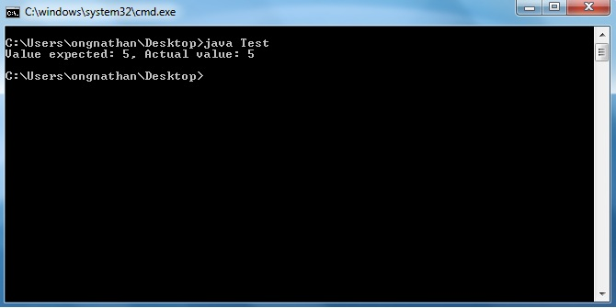
They're the same, YAAAAAYYYYYY!!!

Slide 30
Test 2
public class Test
{
public static void main(String[] args)
{
int x = 2 + 3;
System.out.println("x == 5 is" + (x == 5));
}//end method main
}//End class Test
What is the expected output?

Slide 31
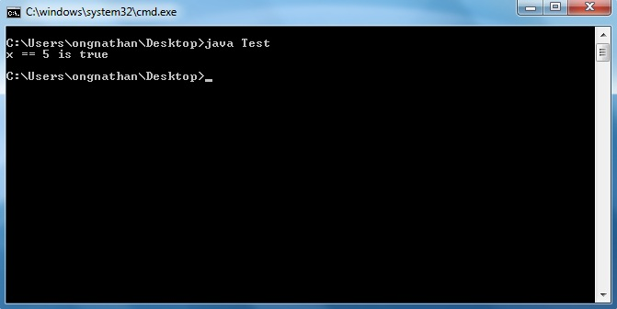
It's true, YAAAAAYYYYYY!!!

Slide 32
Expressions
All primitives allow you to declare/replace
boolean b = (x == 5);
b = (x == 6);
double d = 2.0/3.5;

Slide 33
WARNING
The caret (^) does NOT indicate exponentiation.
In other words, in Java, 2^3 does not equal 8
There is another way to do exponentiation, but we'll come back to this.

Slide 34
Questions?

